Slide 1
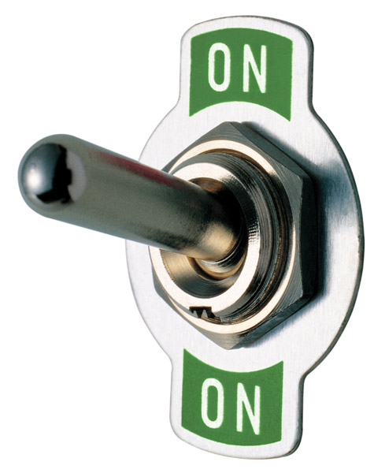
NetApp MetroCluster İle İş Sürekliliği ve felaket kurtarma
Tolga Şentekin
NCDA, NCIE-SAN, NCIE-BR

Slide 2

Genel Bakış
BT Gereksinimleri
Yüksek Devamlılık ve İş Sürekliliği
NetApp MetroCluster İle Süreklilik ve Felaket
Notes:
Putting our discussion in a sharper context, I would like to review with you:
Review the challenges of mitigating risk while without increasing expendatures.
The most common causes of downtime. Some of the results may surprise you and change your thinking about how to prevent them.
I want to take a moment to discuss and define the term Continuous Availability and contrast that between High Availability and Disaster Recovery.
I then want to review MetroCluster, our solution for continuous data availability ;
Show you some typical configuration options
Expose you to some customer experiences
And then close off with any questions and next steps.

Slide 3

Daha az Maliyetlerle İş Sürekliliği ve Felaket Kurtarma
Ekonomik Belirsizlikler ve Bütçe Problemleri
Daha Az ödeyerek daha verimli sistemler kurmak
Değişen iş ihtiyaçlarına kolay uyum ve tüm uygulamalar için süreklilik ve felaket yönetimi
Notes:
Customers today are facing the perfect storm. Challenging economic times are compelling businesses to achieve even greater levels of cost savings and operational efficiency. Yet business-critical applications still require vital data to be protected and available to meet increasing service-level demands. The majority of businesses that fail to protect their critical applications don’t get a second chance, and those that fail to reduce their operational expenses may suffer the same fate.

Slide 4
Sistemsel Hata Kaynakları
Internal Data Center Failures
External Data Center Failures
Source: Forester / Disaster Recovery Journal Global Disaster Recovery Preparedness Online Survey, Oct, 2007
Notes:
4

Slide 5

Geleneksel İş Sürekliliği Modelleri
Geleneksel Yedekli Depolama Birimleri
  Çift Kontrol Ünitesi
  Çift Güç Ünitesi
  Çoklu Soğutma
  RAID Güvenliği
  Çok Yollu Bağlantı
RAID
Connectivity
A
Connectivity
B
Control
A
Control
B
Cooling
A
Cooling
B
Power
A
Power
B
Geleneksel Depolama Üniteleri

Slide 6


Kontroller tabanlı yedekleme Bölgesel Hatalara Karşı Koruma Sağlar
Ekstra yazılım Maliyeti
İki kat fazla Depolama Alanı
Yönetim Karmaşası
  Fazla Depolama Alanı Yönetimi
  Tutarlılık Sağlanması
  Felaket Kurtarma Operasyonları
Primary Data Center
Regional Disaster Recovery Site
Notes:
Remembering that array-based mirroring is design around the invocation of a site-wide disaster, the mechanisms deployed add management and maintenance complexity as well as additional cost.
In other words, just because the primary and backup storage are in the same data center doesn’t mean that the task of failing-over to backup array is any easier. While the data may be instantaneously available, you still need to disrupt operations while you point the applications to the new array, or automate the process through failover scripts.
Array management workload is doubled also. The provisioning of LUNs and file systems must be identical in both arrays and maintaining consistency can become complex. Finally, you most likely have different storage architectures in your data center requiring architecture-specific solutions, further increasing complexity and cost.

Slide 7
Süreklilik ve Felaket Kurtarma
Yüksek Erişilebilirlik (HA) Donanımsal hatalara karşı sistemlerin duraklama olmadan çalışabilmesidir.
  RAID-DP
  Active-Active controllers
İş Sürekliliği Erişilebilirlik kapsamını genişleterek Güç, Soğutma, Network Hataları zamanlı ve zamansız kapanmaya karşı sistemlerin bölgesel hataya karşı korunmasıdır
  MetroCluster
Felaket Kurtarma Bölge genelinde oluşacak hatalara karşı coğrafi olarak farklı bir bölgede sistemlerin erişilebilirliğinin sağlanmasıdır.
  SnapMirror

Slide 8



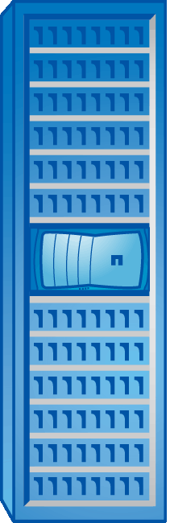

MetroCluster İş Sürekliliği ve yüksek erişilebilirlik
MetroCluster Diğer çözümlere göre %50 az maliyetle her ikisini de kapsar
Kur ve Unut
En Az Değişiklik
Sıfır zaman kaybı ile çalışma
80% fazla okuma performansı
50% düşük maliyet ve tek yönetim modeli ile rakipsiz
Uygulama Entegrasyonu
MetroCluster
Kampüs içerisinde tek bir datacenter
birden fazla yerde, aynı anda.
Notes:
Goal of slide: Demonstrate how MetroCluster as a continuous availability solution can protect against downtime caused inside the data center
Key Points or Key Benefits:
Value of MetroCluster – MetroCluster addresses the need to provide continuous data availability by combining array mirroring with clustered storage controllers. And we can do this with 50% less cost and complexity over the competition.
Let’s talk about each of these supporting values (go to next set of slides)…

Slide 9
MetroCluster Kullanması en kolay Sistemdir
Kur ve Unut
  Kolay Kurulum ve Yapılandırma
Kolay Yönetim
Tek Komutla felaket Çözümü
  İstenirse otomatik Felaket Çözümü Mevcut
  Uygulama ve İşletim Sistemi Bağımsız
Tek Noktadan veri Yönetimi
  Veriler otomatik olarak aynı anda iki yerde
Notes:
Our customers often comment that they are amazed by the simplicity of MetroCluster. You can practically set it up once and it’s ready to go. There is no configuration required on the host to manage data mirroring relationship.
MetroCluster is easy to administer. Upon a site failure, you can manually initiate a site failover via a single command; a method most customers prefer. Or, use MetroCluster TieBreaker application to trigger an automatic site failover. MetroCluster TieBreaker application continuously monitors MetroCluster nodes and has an intelligent in deciding which failure condition is appropriate to execute an automatic site failover. This application is currently operated within NetApp Operations Manager, and therefore has no application or OS dependency.
Another key benefit of MetroCluster is that it eliminates repetitive change management activities. Unlike most mirroring solutions, which require repeated configuration changes in both the source and target array, with MetroCluster you just set it once and changes are reflected in both arrays.

Slide 10


MetroCluster Yönetimi Kolaylaştırır
Site 1
Site 2
Geleneksel
Exchange
Exchange
Oracle
Oracle
LUN Oluşturma
SharePoint
SharePoint
Yeni Alan
Yeni Alan
Replikasyon Kurulumu
Replika Alan
Oluşturma
MetroCluster
Aggregate Mirroring
Yeni Alan
Otomatik Koruma
NetApp Confidential – Limited Use
Notes:
This slide compares MetroCluster to other vendor solutions. Looking at the top half of the slide, with a competitive vendor solution, when you set up a replication relationship you have to create a new volume on the primary data center storage, then you have to create a destination volume on the 2nd storage and set up the replication relationship. That’s 3 steps. With MetroCluster because it is again a clustered solution and b/c it mirrors at the aggregate level, when you create the volume on the primary storage it is automatically set up on the second storage including the replication relationship. That’s 1 step compared to 3. So, anytime to make config changes, etc your management is a lot simpler

Slide 11

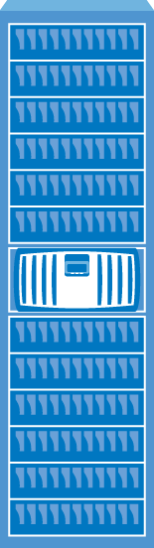
MetroCluster Planlı ve Plansız Durumlara karşı Koruma Sağlar
Sistemi kapatmadan Upgrade ve Update
Uygulamalar her zaman Çalışır Durumda
Upgrade için sistem Durma zamanı yok
İstenirse Downgrade imkanı
Upgrade Complete
Service Restored
Offline for
Software/
Hardware
Update
MetroCluster
Notes:
In addition to addressing unplanned downtime, MetroCluster also eliminates planned downtime. One node in a MetroCluster can be shut down to perform maintenance or upgrade activities without disrupting critical applications. This allow you to replace hardware field replaceable units and provide software upgrades or patches to Data ONTAP transparently. In a future release, nondisruptive disk-shelf replacement will be available.

Slide 12
MetroCluster Kolay ve Hızlı Yönetim
Site 1
1. yansıyı boz
2. online hale getir
Site 2
3. Yansıyı Boz
4. Online Hale Getir
Others
Exchange
Exchange
Oracle
Oracle
5. Yansıyı Boz
6. Online Hale Getir
SharePoint
7. Yansıyı Boz
8. Online Hale GEtir
SharePoint
Yeni Alan
Yeni Alan
MetroCluster
Aggregate SyncMirror
CFOD Komutu
NetApp Confidential – Limited Use
Notes:
It’s just as easy when it comes to addressing unplanned downtime. With other vendor solution, if there’s a failure on the primary, you will have to break the mirror for every volume that you have and bring the 2ndary volume online in the 2nd data center. Image if you had 100s of volumes that can increase you downtime and you could be exposed to human error - e.g. forgetting to bring a volume up online. With MetroCluster, it’s a single command that initiates the failover and bring all the volumes online on the 2ndary site. Scripting is now also available to automate this process should you want that capability.
No need to move anything over from primary to secondary (everything is the same on both side). At the host level may need to move things over (if operating on 2nd site, then may need to move things over) otherwise, MC can pick up the IP addresses of the primary host so no changes need to be made to redirect host to 2nd site.
Benefit: Reduced unplanned downtime and human error.

Slide 13
MetroCluster Okuma Performansını Arttırır
Dengeli Okuma/Yazma İslemleri
100% Okuma İşlemleri
+33%
+80%
+55%
+25%
SFS Benchmarks
Notes:
Read-intensive applications:
Credit card processing
Web apps like iTunes, FaceBook, etc.
Insurance apps.
Another benefit that MetroCluster provides is additional read bandwidth. This comes handy if the system has a reasonable read workload and it is running disk-bound.
These charts compare Standard FAS systems with MetroCluster-equipped configurations in a disk-bound SFS environment with both, balanced and random read/write workloads. The results show that with MetroCluster you not only achieve continuous availability, but you can potentially realize significant application response time improvement.

Slide 14

MetroCluster Diğerlerinden %50 ucuza iş sürekliliği ve yüksek erişilebilirlik sağlar
50% Daha Ucuz
50% Daha Az Yönetim
  Otomatik Koruma Sağlar
  Karışık yapılara ihtiyaç duymaz
  Upgrade ve bakım için durmaz
Notes:
NetApp MetroCluster is highly cost-effective… [Read Bullet Points]

Slide 15
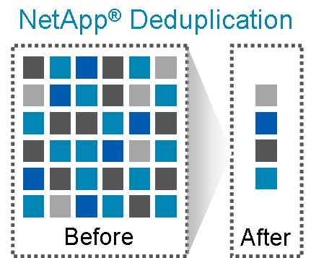
MetroCluster ile verimli alan kullanımı
Tekilleştirme alandan tasarruf sağlar
  Hem kaynak hem hedef alanlar için tekilleştime
Kullanıcı kapasite kullanımı*:
  25-30% ortalama kazanç
  50-90% sanal ortamlardaki alan kazancı
*Based on NetApp AutoSupport data
Notes:
NetApp deduplication offers storage efficiency across all storage tiers: primary data, backup data, and archival data. NetApp deduplication is included with all NetApp FAS3000, FAS3100, FAS6000, and V-Series systems. Unlike other deduplication solutions, no additional hardware or software licenses are required, and NetApp deduplication is application and protocol agnostic.
Based on customer feedback and AutoSupport data, customers are, on average, realizing 25 percent to 30 percent capacity savings. And 50 percent to 90 percent savings in virtualized environments. MetroCluster practically pays for itself with the savings customers achieve with deduplication in a virtualized environment.

Slide 16
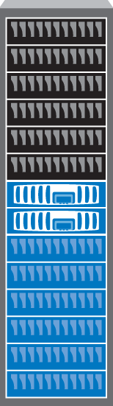
MetroCluster Esneklik Sağlar
Şehirler Arasında
MetroCluster katlar, Binalar, Kampüs Alanları ve Hatta Şehirlerarası iş sürekliliği ve erişilebilirlik sağlar.
FAS3000, FAS3100, FAS3200, FAS6000 & V-Series
Kat, Bina Kampüs içerisinde
Datacenter İçinde
MetroCluster –500 m kadar Uzayabilir
MetroCluster 100 km Kadar Destekler!!
MetroCluster
Notes:
MetroCluster can address your continuous availability requirements, whether it is deployed inside a data center; (click for animation) at different locations in a building; (click for animation) or across city or metro-wide deployments up to a maximum distance of 100km. This enables a level of availability that goes beyond the high-availability features in a single array which makes MetroCluster a highly versatile solution.
MetroCluster supports NetApp FAS3000, FAS3100, FAS6000 and V-Series.

Slide 17
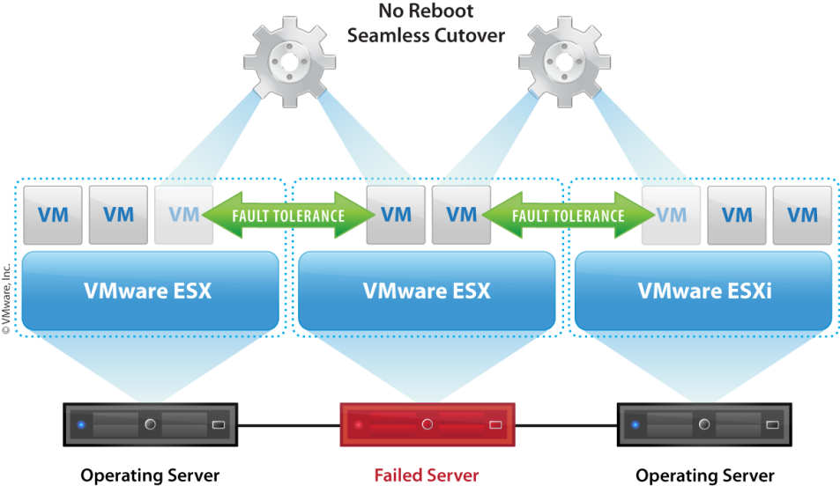
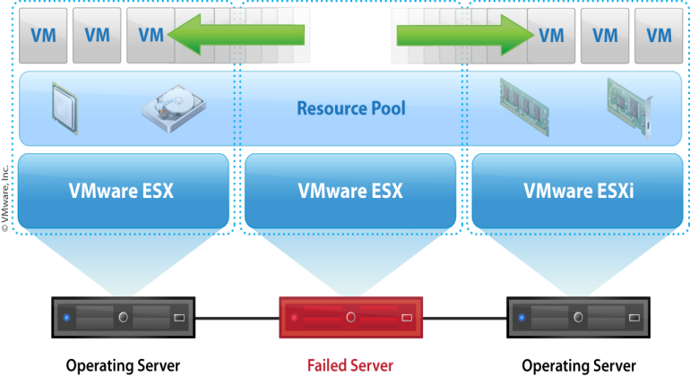
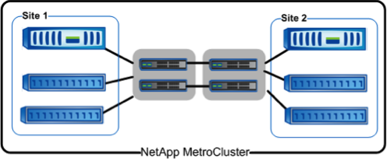
Sanal Ortamlarda Rakipsiz İş Sürekliliği ve Erişim
MetroCluster +
VMware HA
MetroCluster +
VMware FT
Notes:
Many companies have employed server virtualization technologies to reap the benefits of increased server consolidation and utilization. And as more customers look to virtualization as a means to cost effectively manage their server environment, they want to extend virtualization to their mission critical applications which also requires a higher level of data availability. Things you already know.
NetApp and VMware have collaborated to deliver an end-to-end continuous availability solution from virtual server to storage environment. We started with VMware HA and now extending it to VMware Fault Tolerance (FT) which was introduced with vSphere. This provides continuous availability of virtual machines w/o impact to the users, and complements NetApp MetroCluster that protects against storage failures enabling continuous data availability access.
VMware FT essentially allows any VM to survive a server crash without any interruption in service— what this means is user experiences zero downtime and zero data loss! This is based on vLockstep technology, VMware FT runs a primary VM and secondary VM in synchronized, lockstep using no special hardware. This allows users to protect more MISSION CRITICAL applications that they otherwise could not have protected, all with lower cost and high ease of use.

Slide 18


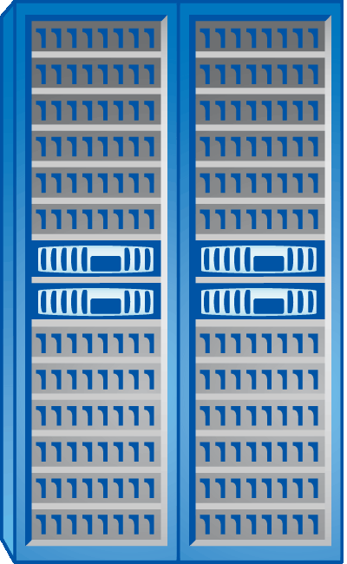


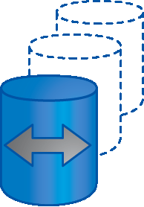










Tüm Bölgelerde Entegre Süreklilik
Merkez Data Center/Kampüs
Manage
and Monitor
Uygulama
Yazılımları
Süreklilik ve Erişim
Felaket Bölgesi
Felaket Kurtarma
Snapshot™
Copies
Dev/Test için kullanım
Uygulama
Arşivi
Yedekleme
Uzak Ofis
Notes:
Goal of slide: Show what how MetroCluster fits into the NetApp Data Protection portfolio.
Key Messages or Key Benefits:
All functions are integrated into NetApp storage and available as needed.
Show the availability components and local backups. Snapshots w/ SnapManager + Continuous availability + DR + Business agility (FlexClones)
Build 1) Show the addition of backup for long term protection both for NetApp and non-NetApp (remote office) systems.
Build 2) Show the addition of archive / ECM for long term retention & compliance requirements.
So, customers can achieve continuous availability protection with MetroCluster against data center failures and Disaster Recovery protection with SnapMirror against the loss of an entire data center.

Slide 19
Teşekkürler
Notes:
Thank you.

